Slide 1


A New Method For Developing IBIS-AMI Models

Slide 2
Hongtao Zhang, hongtao@xilinx.com
John Baprawski, john.baprawski@gmail.com
Pegah Alavi, pegah_alavi@keysight.com
Geoff Zhang, geoffz@xilinx.com

Slide 3
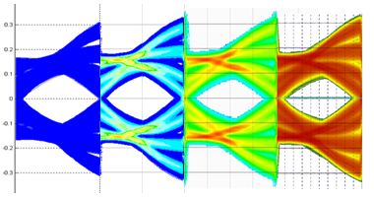

Executive Summary
Model simulation speed is about five times faster
Model achieves good matching to the circuit simulation
Runs in various simulators (ADS, QCD, HyperLynx, …)
Circuit ADS QCD HyperLynx

Slide 4
Outline
Motivation and Introduction
IBIS-AMI Model Development Challenges
Proposed IBIS-AMI Development Flow
Engineering Trade-offs
An IBIS-AMI Model Development Example
Results, Verification, and Correlation
Conclusions

Slide 5

Motivation and Introduction
Accurate and fast link simulation is required at early system design stages to avoid over-design or under-design and to assess margin
SerDes vendors desire a convenient IBIS-AMI model development flow that deals with the development challenges

Slide 6

IBIS-AMI Model Development Challenges
Architecture development vs. IBIS-AMI model generation
Circuit vs. IBIS-AMI model representation
Model abstraction
Model development
Model compilation
Model debug

Slide 7
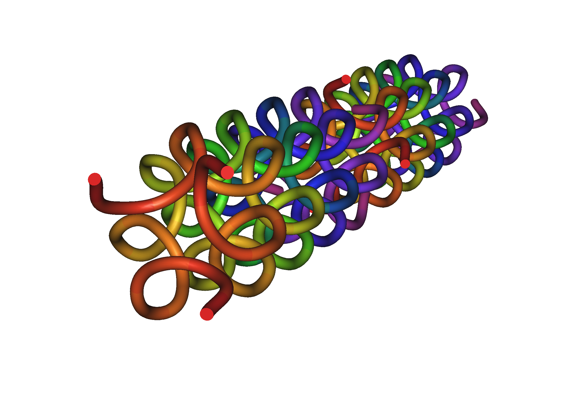
IBIS-AMI Model Development Challenges (Cont’d)
Architecture development vs. AMI model generation
  AMI model is more than architecture model
  Need to match design implementation
  Need to reflect silicon behavior across PVT

Slide 8

IBIS-AMI Model Development Challenges (Cont’d)
Circuit vs. IBIS-AMI model representation
  Identify and categorize circuit into LTI and NLTV systems
  Frequency domain vs. time domain LTI modeling
  Modeling of nonlinear circuit behavior
  Modeling of time varying circuits

Slide 9

IBIS-AMI Model Development Challenges (Cont’d)
IBIS-AMI model abstraction
  Decide which parts of the model to place .ibs or .dll (.so)
  Identify signal flow and control flow
  Code signal flow into interconnected LTI and NLTV blocks
  Parameterize relevant control signals

Slide 10
IBIS-AMI Model Development Challenges (Cont’d)
AMI model development requires many skills
  Master C/C++ coding skills
  Guarantee coding compatibility across platforms
  Compile and link program in both Windows and Linux
  In depth understanding of IBIS-AMI standard

Slide 11
IBIS-AMI Model Development Challenges (Cont’d)
AMI model debug
  Need to maximize code development efficiency
    Debug algorithmic code within one model development platform, independently from use in any Channel Simulator
  Need to minimize delivered code debugging
    Only debug ported AMI model in Channel Simulator for possible code interface problems

Slide 12

Proposed IBIS-AMI Development Flow
Model hierarchy partition
Modularization and component reutilization
Debugging hooks embedding
Scripting and automation

Slide 13
Proposed IBIS-AMI Development Flow (Cont’d)
Model hierarchy partition
  Model nonlinear analog circuit in AMI portion
  Match circuit hierarchy closely
  Separate analog modeling from digital modeling
  Separate data flow path from control flow path

Slide 14

Proposed IBIS-AMI Development Flow (Cont’d)
Modularization and component reutilization
  Minimizes coding maintenance and verification load
  Reduces model development cycle
  Helps in hierarchy building
Debugging hooks insertion
  Early planning
  Debug source code vs. DLL/SO

Slide 15

Proposed IBIS-AMI Development Flow (Cont’d)
Scripting and automation
  Have a wrapper script to generate IBIS-AMI ready code from the core code
  Automate the .ami file generation based on model parameter list
  Eliminate redundant work
  Guarantee the robustness of the compilation and build process
  Ensure IBIS-AMI compliance

Slide 16

Engineering Trade-offs
Accuracy vs. speed
Custom models vs. library models
Hierarchy levels

Slide 17

Engineering Trade-offs (Cont’d)
Accuracy vs. speed
  Higher accuracy typically comes with lower speed and longer development cycle
  Balance the accuracy level and the simulation speed of each component to achieve optimal accuracy and acceptable simulation speed

Slide 18

Engineering Trade-offs (Cont’d)
Library models
  save development time
  reduce the chance of error
  Good for initial model generation and proof of concepts.
Custom models
  improve model accuracy
  enhance programming flexibility
  requires full verification
  increases development time

Slide 19

Engineering Trade-offs (Cont’d)
Hierarchy levels
  Maximize coding flexibility
  Code reuse and maintenance
  For design match up and correlation
  For debugging and model enhancement

Slide 20
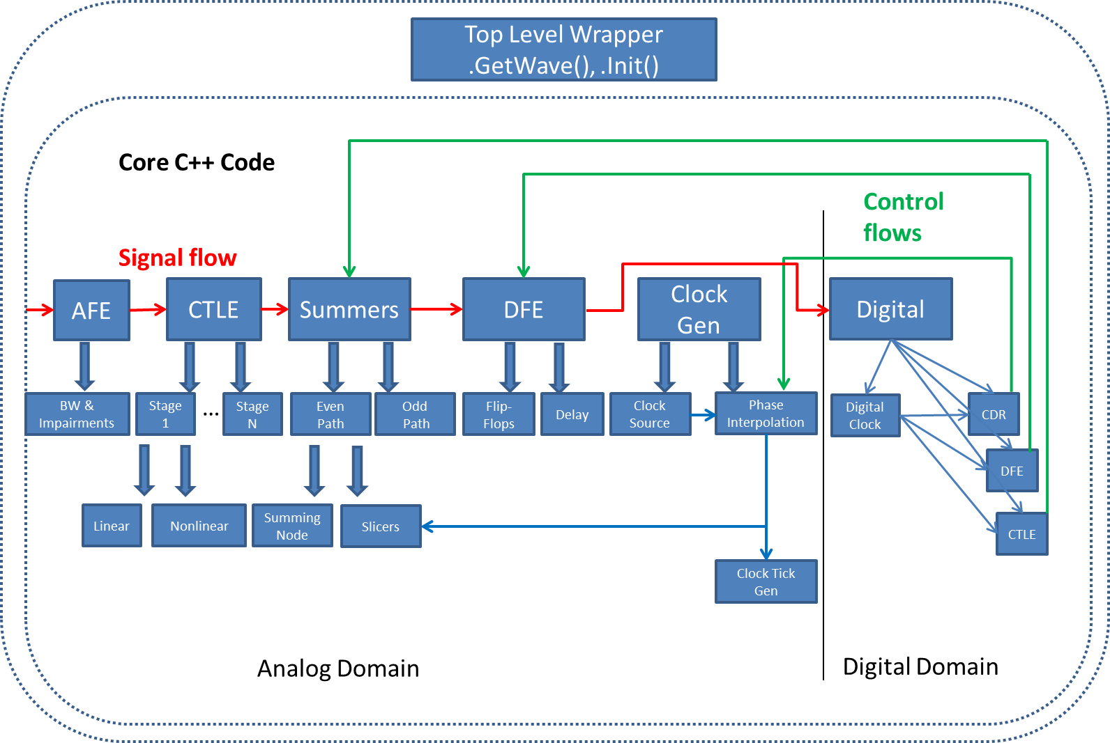
An IBIS-AMI Model Development Example (RX)
Six modules
Customized modeling
Speed & mem optimization

Slide 21
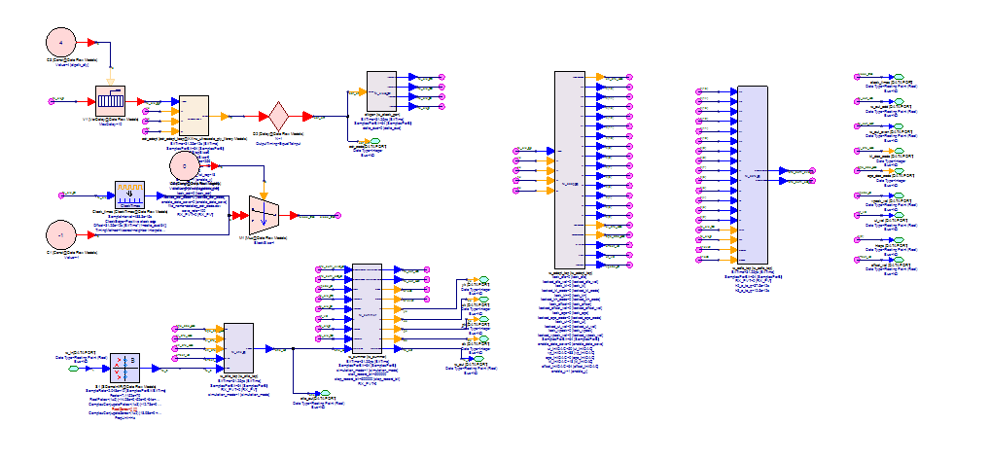
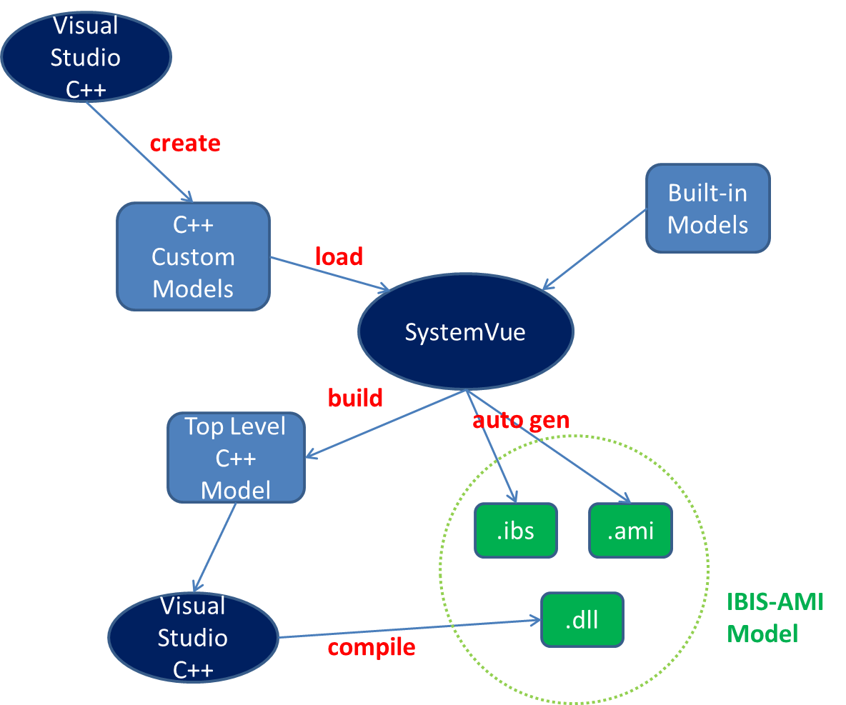
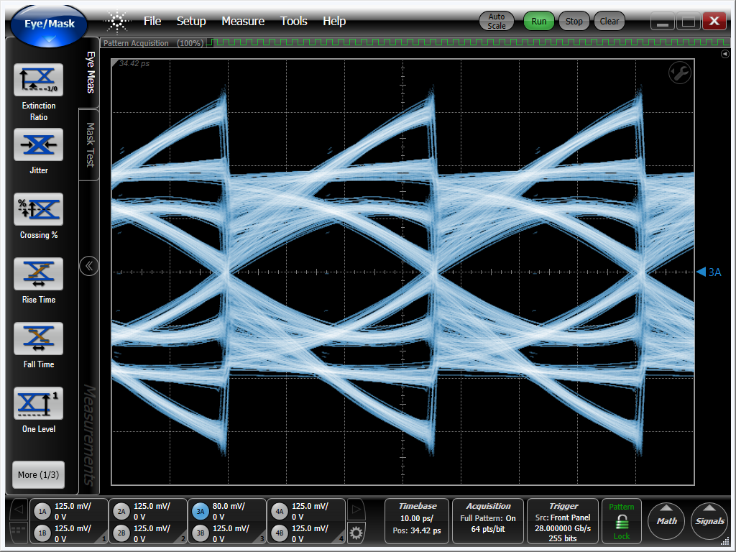
An IBIS-AMI Model Development Example (Cont’d)
Assembled and debugged in SystemVue
Compilation process is automated
SystemVue model
Probe and debug

Slide 22
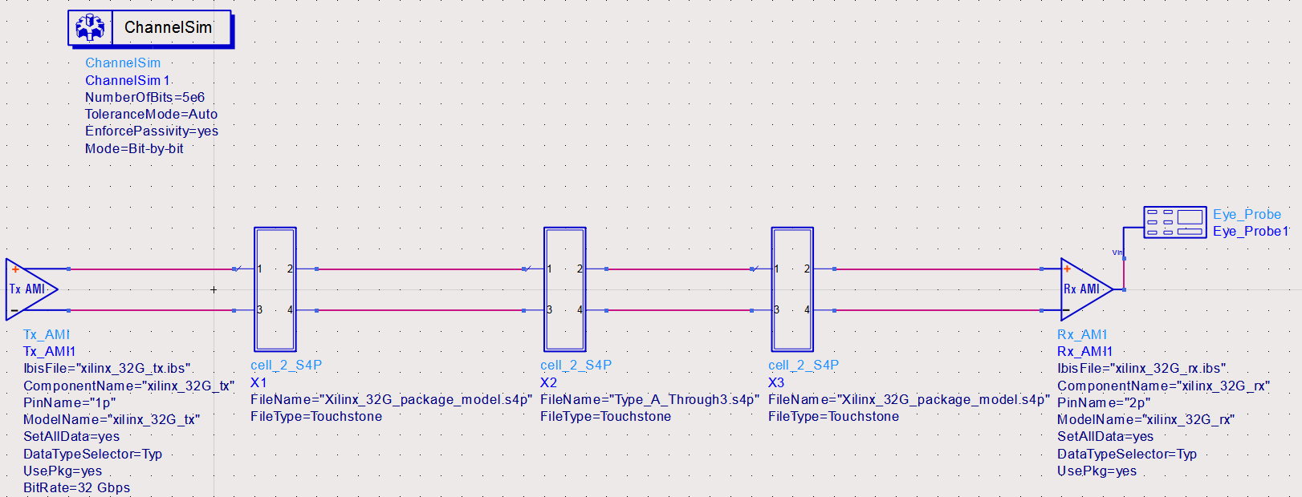
Results Verification and Correlation
Both TX and RX models are generated by the same flow
The models verified on multiple EDA tools
Results correlate with design

Slide 23
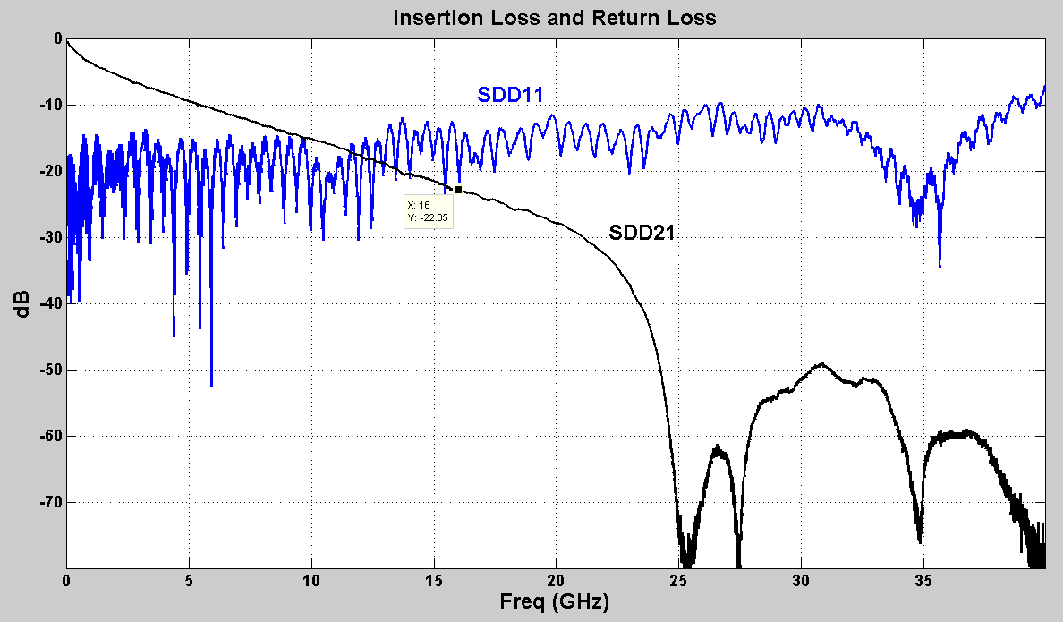
Results Verification and Correlation (Cont’d)
Example 1:
Simulated at 32Gbps
IL = 22dB at 16 GHz
RL = 17dB at 16 GHz

Slide 24
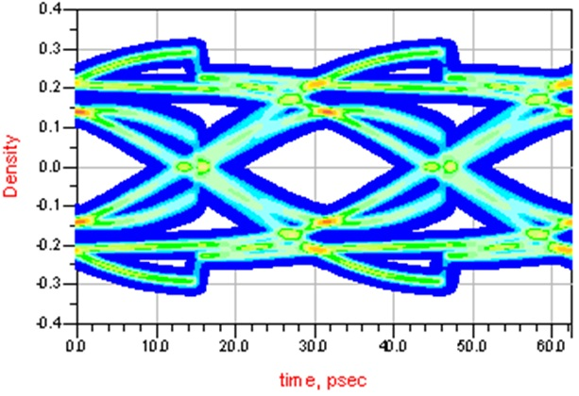
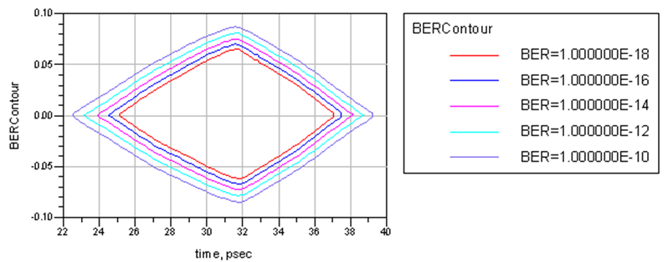
Results Verification and Correlation (Cont’d)
32 Gbps, 22dB loss channel
BER<1E-18 with 120mV margin

Slide 25
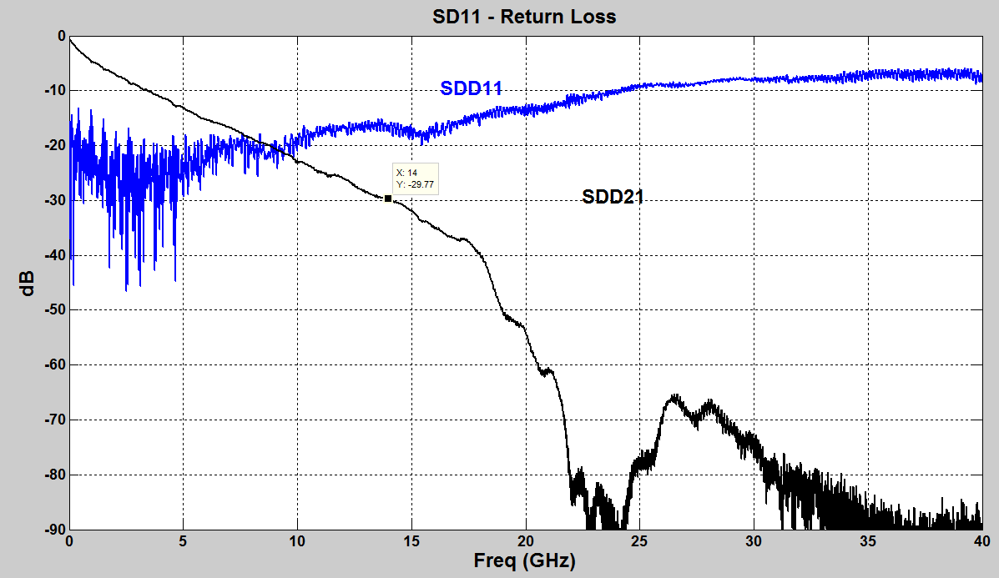
Results Verification and Correlation (Cont’d)
Example 2:
Simulated at 28Gbps
IL = 30dB at 14 GHz
RL = 18dB at 14 GHz

Slide 26
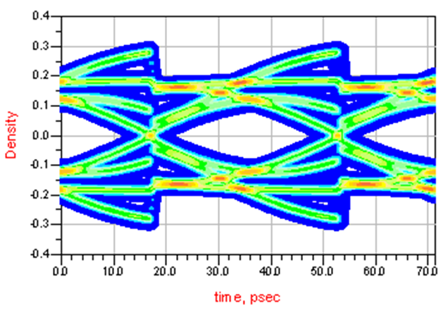
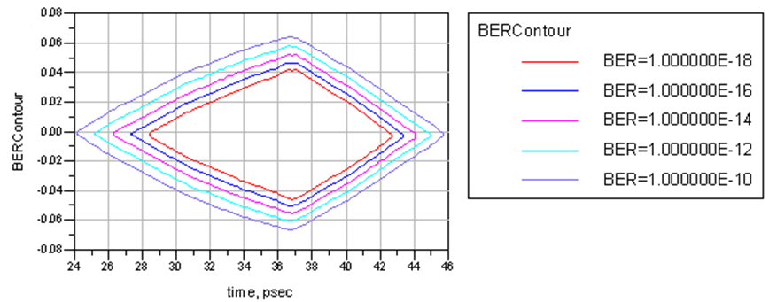
Results Verification and Correlation (Cont’d)
28 Gbps, 30dB loss channel
BER<1E-18 with 80mV margin

Slide 27
Results Verification and Correlation (Cont’d)
Verified across various EDA tools on Linux and Windows
Achieved general matching
  Matched TX output waveform with design transient simulation
  Matched RX internal waveform with design transient simulation
Simulation takes about 6 minutes per one million bits
Will correlate with and match to silicon in the future

Slide 28
Conclusions
Challenges and trade-offs often encountered in IBIS-AMI model development are discussed and addressed in this presentation
Hierarchy partition, modularization and reutilization, debugging hooks embedding, scripting and automation form the practical IBIS-AMI development flow proposed
This flow not only helps to reduce model generation cycle, but also assures acceptable simulation speed and good accuracy

